Slide 1

INTERVIEWS
Communication Skills

Slide 2

GROUP MEMBERS:
GROUP MEMBERS:
AAMNA TAHIR 21-ARID-377
ALISHBA KHATEEB 21-ARID-392
MARIYAM CHAUDHARY 21-ARID-440
SEEMAB HASSAN 21-ARID-504

Slide 3

GROUP MEMBERS:
TABLE OF CONTENTS:
INTRODUCTION
DO’S AND DON’TS OF INTERVIEWS
STAGES OF INTERVIEWS
TYPES OF INTERVIEWS
CONCLUSION

Slide 4

INTERVIEW
Interview - An interview is a structured conversation where one participant asks questions, and the other provides answers.

Slide 5



Why?
To judge the overall personality of the candidate.
To know whether you are able to perform the required job or not.
To judge the skills and attributes which are not mentioned in C.V.
Apart from your knowledge your ability and capacity to do the job.
To find out what motivates you, how well you communicate.
Your actual strengths and weaknesses.

Slide 6
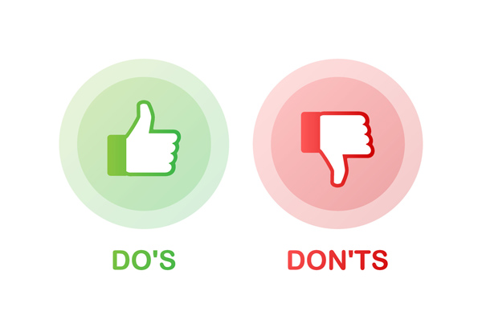

Slide 7
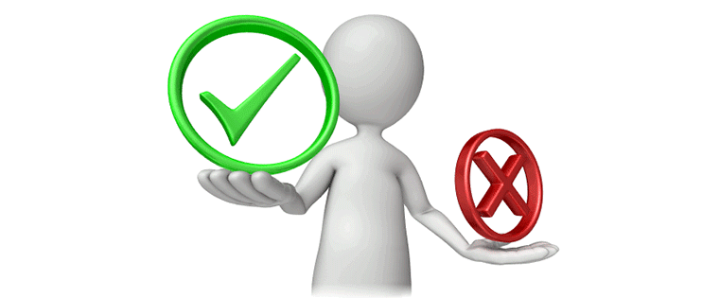


DO’S AND DON’TS
Research the company and the position you're applying for.
Research common interview questions and practice your answers.
Dress appropriately for the job you want, be neatly groomed, and dress relatively conservatively.

Slide 8
DO’S AND DON’TS
Rehearse your answers so much that you sound like you're just reciting from memory.
Arrive smelling ( too much perfume, cigarette smoke, etc.)
Don't act nervous.
Don't ramble.
Don't ask about money.

Slide 9
STAGES OF INTERVIEW PROCESS
Introduction
Small talk
Information gathering
Question Answer
Wrapping up

Slide 10

INTRODUCTION
Introduction phase :
Opportunity to make a positive first impression
Strong start:
Handshake, standing confidently and good eye contact
Inspiring attitude:
Find a comfortable sitting position
Lean forward to show interest and smile at appropriate times.

Slide 11
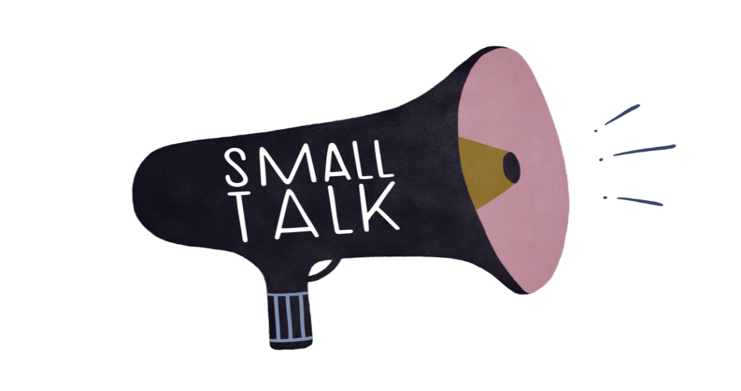
SMALL TALK
Good idea:
After introductions, it is a good idea to conduct a bit of small talk.
Importance:
Small talk encourages a healthy working relationship and build link.
Avoid serious talk :
Do not talk about religion or politics to avoid awkward situation.
Positivity :
Keep the discussion positive.

Slide 12

QUESTION AND ANSWER PHASE:
Longest portion of the interview:
Questions and then your responses is the longest portion.
Duration:
If the interview is a 30-minute screening interview, this portion is typically about 20 minutes long.
Getting to know you:
Be prepared to talk about your work experience, skills, education, activities, and interests.

Slide 13

QUESTION AND ANSWER PHASE
Strengths, experiences, knowledge and interests:
Talk about past accomplishments, and technical experience and also highlight your strengths. Convey knowledge and interest.
Team work and communication skills:
Show clear, effective communication skills and the ability to work effectively with other team members.
Willingness and abilities:
Show willingness, ability to adapt and ability to perform in future.

Slide 14

YOUR QUESTIONS:
Knowledge about organization:
Always come prepared to demonstrate your knowledge of the organization by asking thoughtful questions.
Ask prepared questions:
Bring at least three questions, but also feel free to modify the questions
Make notes:
Be sure to make notes as the interviewer answers your questions.

Slide 15
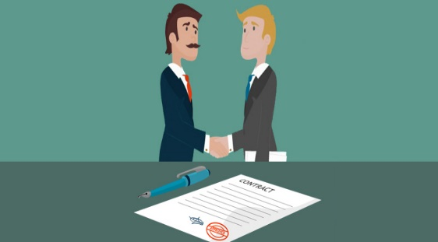
CLOSING:
End on a positive note:
At the end take the time to end on a positive note.
Fit for position:
It’s opportunity to tell them why are you fit for this position.
Ending
Thank them for the invitation to interview and offer a firm handshake while making good eye contact.
Ask for the job:
And most importantly, ask for the job!

Slide 16
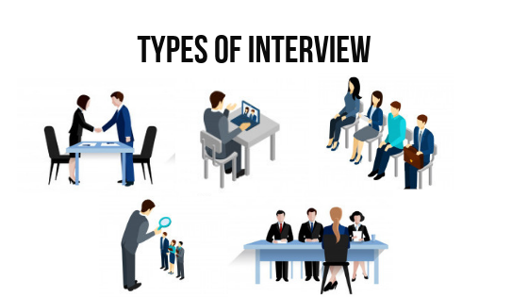

Slide 17



1. Informational Interview
In an informational interview the objective is to seek advice and learn more about a particular employer, sector or job. As a result, gaining this information means you are more prepared. It is also an excellent way of networking and adding to your contacts.

Slide 18

2. Individual Interview
Often referred to as a “personal interview” this is the most common type of interview and is usually held face to face at the company’s offices. Shorter interviews will mean delivering concise answers that are to the point.

Slide 19

3. Telephone Interview
Phone interviews are proving to be a more cost effective way to screen candidates. Slots range from 10 to 30 minutes.
Firstly, prepare for it as if it is an open book exam. Secondly, make sure you have your CV, the job description, list of references and prepared answers noted in front of you.

Slide 20


4. Group Interview
A group interview is an interview technique in which several candidates are interviewed simultaneously for similar positions. To be successful, group interviews must be well planned and executed.

Slide 21
5. Behavioral-Based Interview
Known as Critical Behavioral Interviewing (CBI). It is an interviewing technique which employers use to evaluate candidate's past behavior in different situations in order to predict their future performance. By this interviewer can predict about your IQ level, efficiency of work, and your decision making ability in professional environment.

Slide 22
How to Tackle?
Q: “Give me an example of when you showed initiative and took the lead?”
The recommended way is S.T.A.R. (Situation , Task, Action , Result) technique. For each question, describe the Situation (your role and responsibilities) ;talk about the Task; explain your Action and the Result (the benefit accrued by the company as a result of your action).

Slide 23


7. Panel Interview
A panel interview is in when two or more interviewers interview you at the same time. The panel can consist of a mix of people. It may be the supervisor and several team members. Or, it might be an HR representative and several colleagues.

Slide 24
Panel VS Group Interview
Don’t confuse a panel interview with a group interview. In a panel interview, multiple interviewers are interviewing you at the same time (meaning you are the only candidate in the room). However, in a group interview, while there may be multiple interviewers, there are also multiple candidates interviewing at the same time.

Slide 25


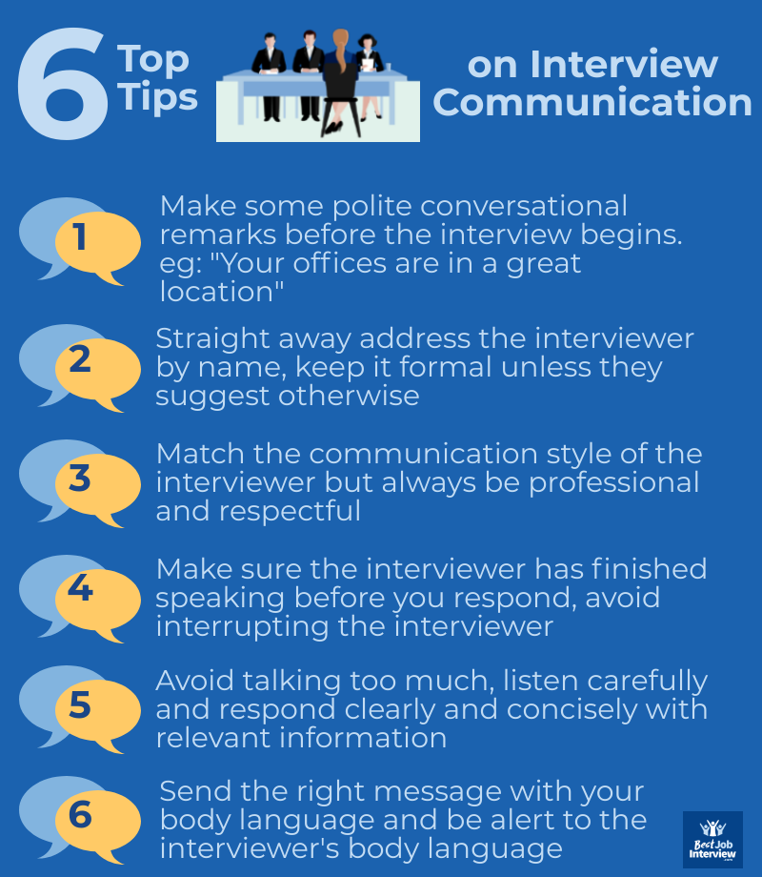

Slide 26


ANY QUESTIONS?

Slide 27



THANK YOU!
THANK YOU!

